Slide 1
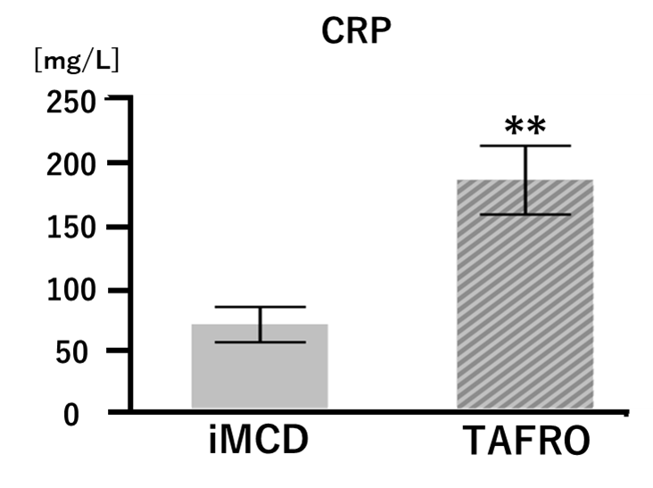
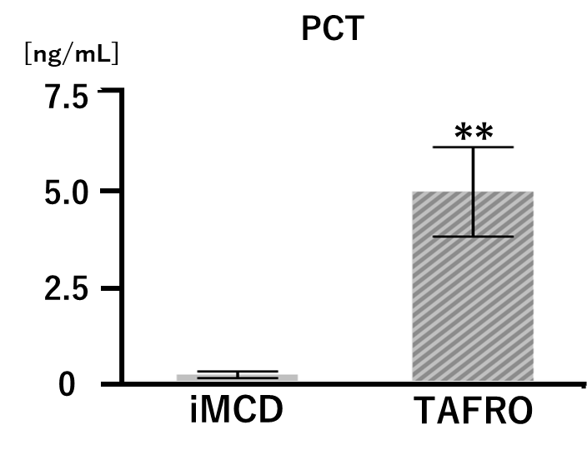
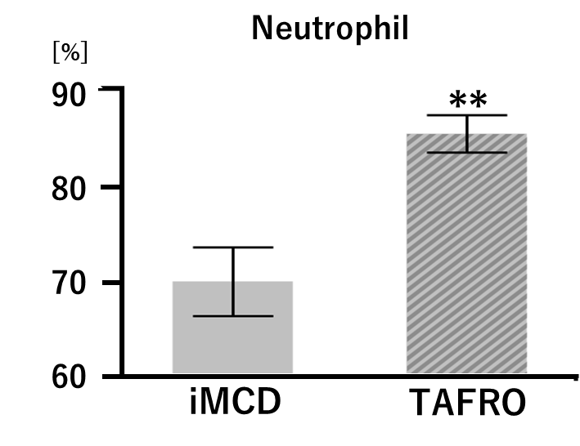
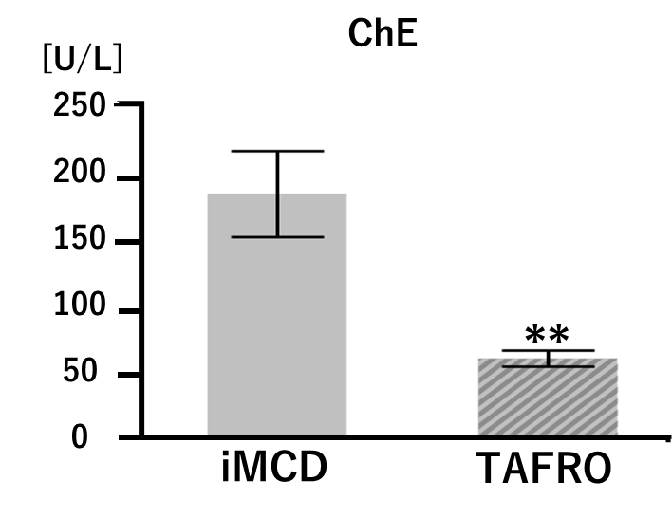
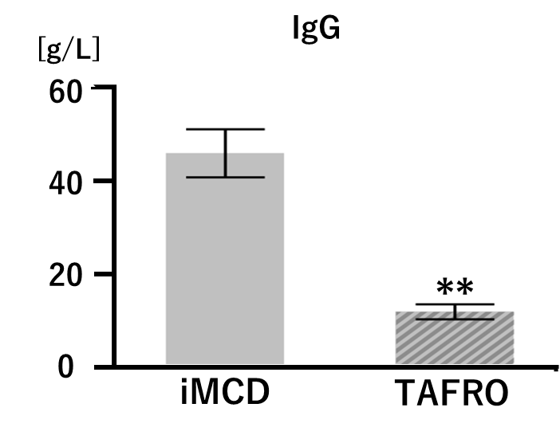
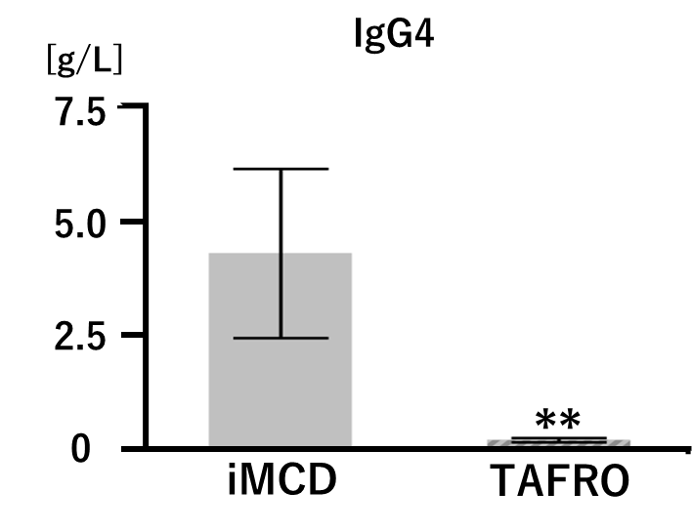
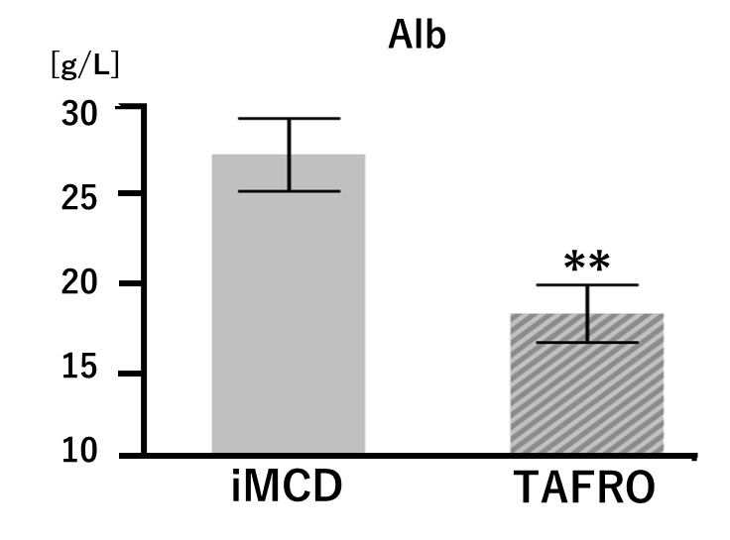
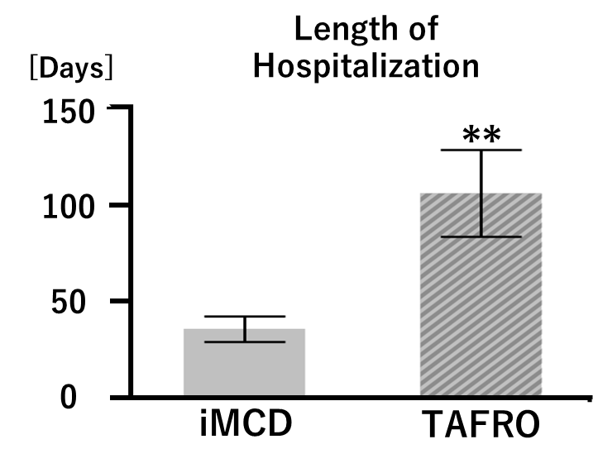
Fig. 1

Slide 2
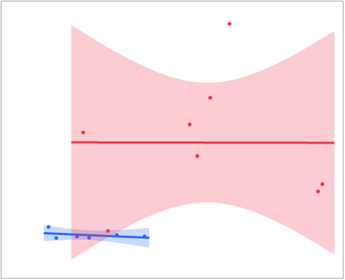
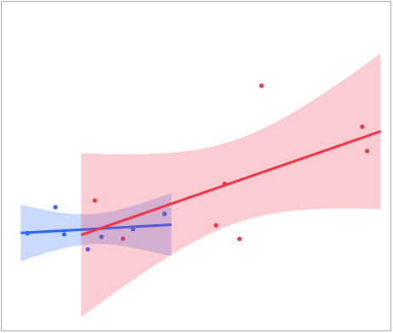
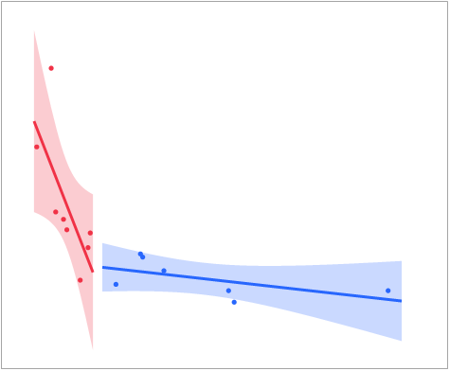
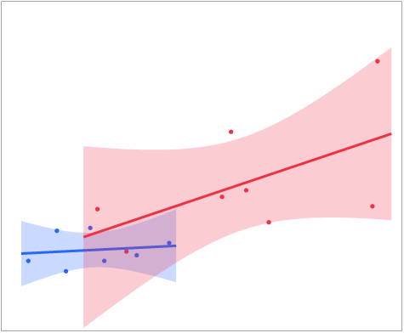
Fig. 2
iMCD
R² = 0.151
p = 0.4463
TAFRO
R² = 0.013
p = 0.9957
iMCD
R² = 0.033
p = 0.6982
TAFRO
R² = 0.366
p = 0.1122
PCT
[ng/mL]
ALP
[U/L]
12
8
4
0
2000
1500
1000
500
0
-500
CRP
[g/dL]
CRP
[g/dL]
0 75 150 225 300
0 75 150 225 300
iMCD
LOS
[Days]
LOS
[Days]
TAFRO
iMCD
R² = 0.331
p = 0.1763
TAFRO
R² = 0.520
p = 0.0434*
iMCD
R² = 0.022
p = 0.7523
TAFRO
R² = 0.318
p = 0.1458
300
200
100
0
300
200
100
0
ChE
[U/L]
CRP
[g/dL]
0 100 200 300 400
0 75 150 225 300

