Slide 1
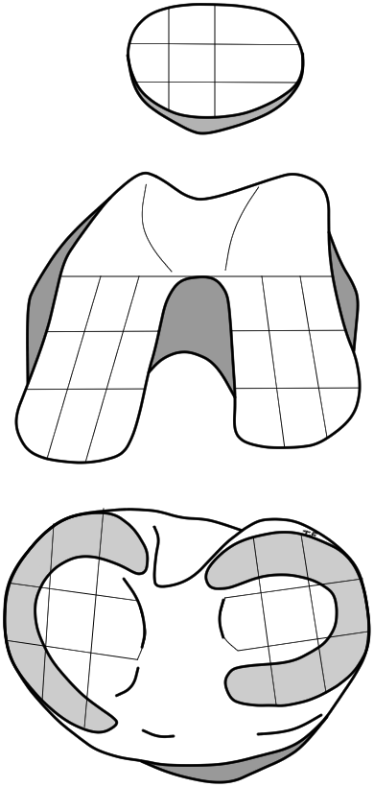
a
P
b
P1
P2
P3
P1
P2
P3
P
P4
P5
P6
P4
P5
P6
P7
P7
P8
P9
P8
P9
T1
T
T1
T2
T3
T2
T3
MFC
MFC
MFC
LFC
LFC
MFC
LFC
MFC
MFC
LFC
LFC
1
2
3
1
2
LFC
1
2
3
1
2
3
3
MFC
MFC
MFC
LFC
LFC
MFC
LFC
LFC
MFC
MFC
MFC
LFC
LFC
4
5
6
4
5
LFC
4
5
6
4
5
6
6
LFC
LFC
MFC
MFC
LFC
LFC
LFC
MFC
MFC
MFC
LFC
8
9
7
8
MFC
7
8
9
7
8
9
7
9
MTP
LTP
MTP
LTP
8
8
8
8
LTP
LTP
MTP
LTP
MTP
LTP
MTP
LTP
LT5
MTP
LTP
MTP
6
4
MTP
MTP
LTP
LT5
6
4
5
4
5
5
6
4
5
6
MTP
LTP
MTP
LTP
2
2
2
2
MTP
Fig. 1

Slide 2
a
0
0
0
b
0
0
0
0
0.1
0
0.1
0.2
0.1
0
0
0
0
0
0
0.1
0.3
0
1.0
0.2
0.3
0
1.0
0.2*
0.1
0
0
0
0
0
0
0
0
0
0.8
0
0.8
0.1
0.3
0.4
0.7
0.1
0
0
0.4*
0.5
0.2
0.1
0
0
0
0
0
0
0
0.6
0
0
0
0
0
0
0.6
0.4
0.4
0
0.1
0.2
0
0.3
0.2
0.1
0.1
0.1
0.4
0.1
0.3
0.6*
0.7
0.3
0.1
0.3
0.4
0.3
0
0.4*
0
0
0.1
0
0
Fig. 2

Slide 3
a
0.3
0.1
0.1
b
0.4
0.3
0.2
0.4
0.4
0.1
0.5
0.7
0.2
0.2
0.1
0.1
0.2
0.3
0.2
0.5
0.7
0
1.0
0.7
0.8
0
1.0
0.2
0.1
0.5*
0.2
0.2
0.1
0.4
0.3
0.2
0
0
0.8
0.3
0.8
0.7
0
0.7
0.3
0.9
0.7
0.4
0.3
0.6
0.7*
0.2
0.5
0.1
0.6
0
0.6
0
0
0
0.3
0.2
0.2
0.1
0.1
0.4
0.4
0.4
0.4
0.1
0.2
0.1
0.3
0.2
0.2
0.7
0.2
0.3
0.6
0.4
0.1
0.4
1.0*
0.2
0.1
0.5
1.0*
0.6*
0.9*
0.1
0
0.3
0
0.1
0.2
0.4
Fig. 3

